Slide 1
JavaScript

Slide 2
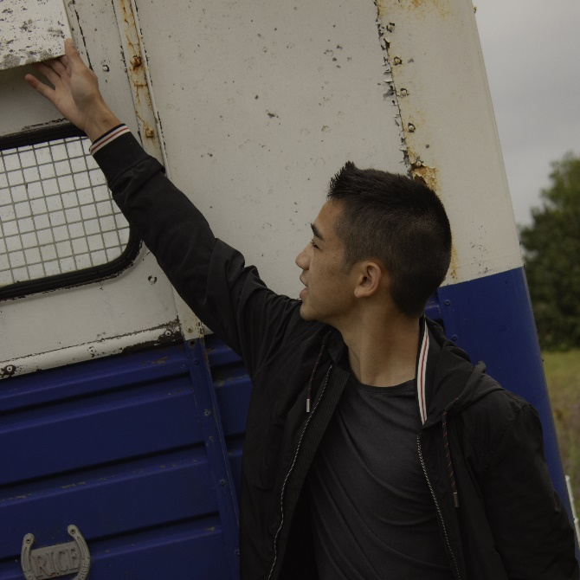
Hello!
I am Xavier Chanthavong
Web Design Mentor in Hack Club
You can find me at @XavierChanth

Slide 3
Itinerary
Basics?
You already
know them.

Slide 4
Itinerary
Async Functions
Fetch
Challenge

Slide 5
Ok real quick.

Slide 6
1.
Basics
Variables?
Just change it to var
Constant variable?
Change it to const.

Slide 7

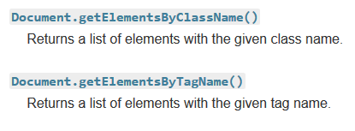
1.1
Dom Elements
Window
Document
From MDN (https://developer.mozilla.org/en-US/docs/Web/API/Document)

Slide 8
Some quick resources
MDN
W3 Schools
(Use it like Wikipedia)

Slide 9
2.
Three ways to synchronize
Callback functions
Async/Await
Promises
Today I will teach you the basics.

Slide 10
Callback Hell:
When you get TOO MANY layers deep in callbacks

Slide 11
Fetch Demo

Slide 12
CS Mixer Feb 15, 5-8:30pm UB 1055

Slide 13
Final Web
Challenge

Slide 14
Build: A pokedex using this api
https://pokeapi.co/

Slide 15
Requirements
Must:
-Be able to fetch Pokémon data from the api
-Search for Pokémon (by name, number etc.)
-Display Pokémon to the HTML document
Bonus:
-Make it pretty
-Get Creative! Add your own features.

Slide 16
For inspiration:
https://pokedex.org/
Don’t make a clone though.

Slide 17
Thanks!
👍
Any questions?
You can find me at @XavierChanth

